Slide 1
Scaling Learning to Rank to Big data
A study concerning the parallelisation of learning to rank algorithms using the mapreduce computing model

Slide 2
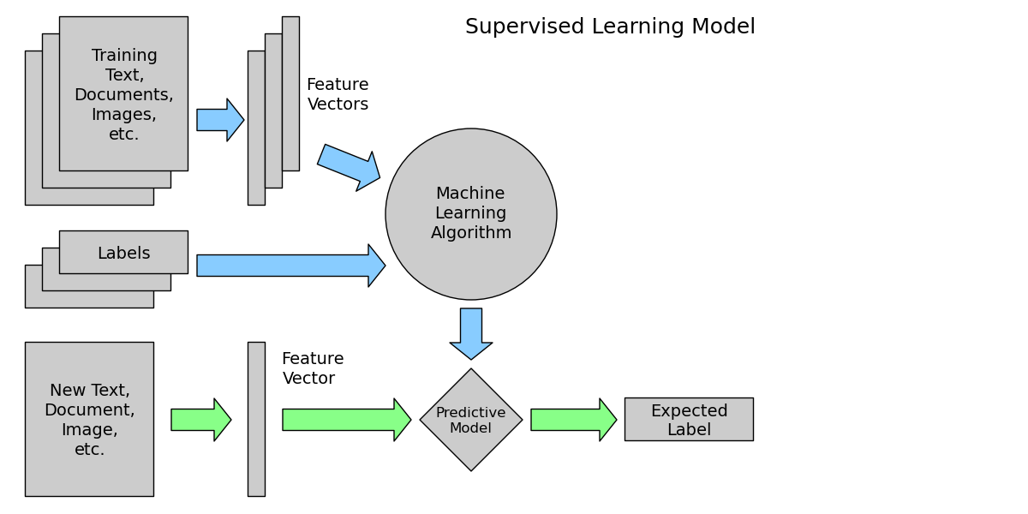

Slide 3
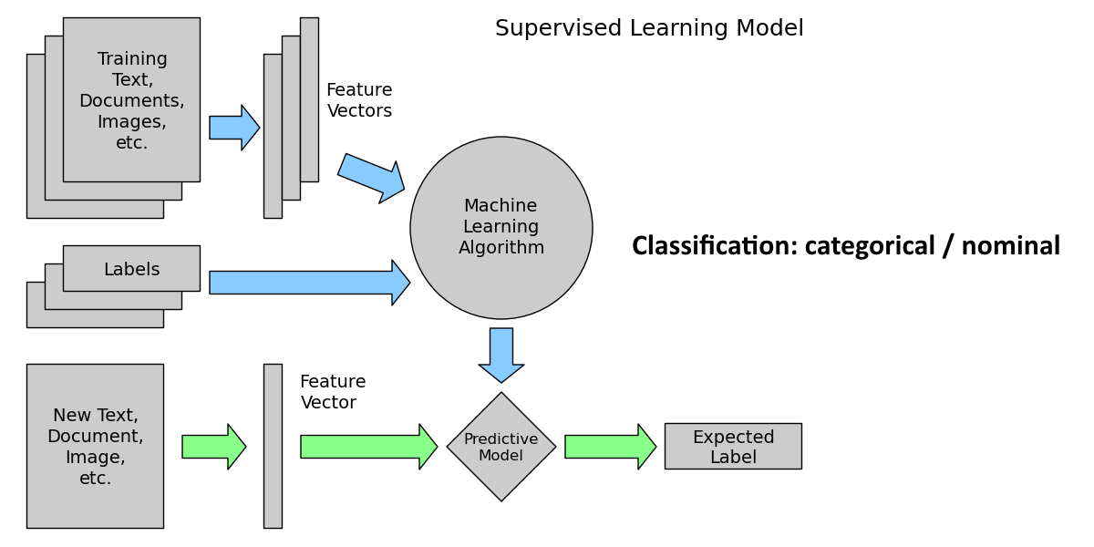

Slide 4
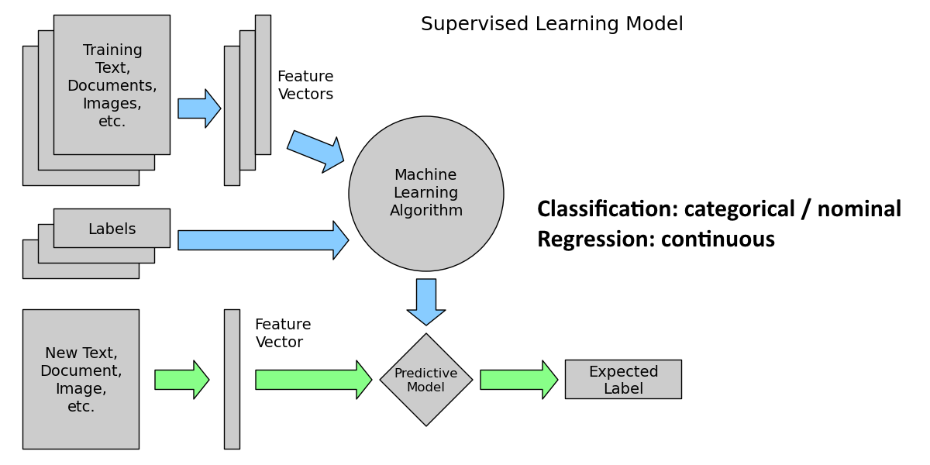

Slide 5


Slide 6


Slide 7


Slide 8


Slide 9


Slide 10


Slide 11


Slide 12



So… what makes a good ranking?
Normalized Discounted Cumulative Gain
Highly relevant documents are more useful than marginally relevant documents
Highly relevant documents are more useful when appearing higher in a search engine result list

Slide 13
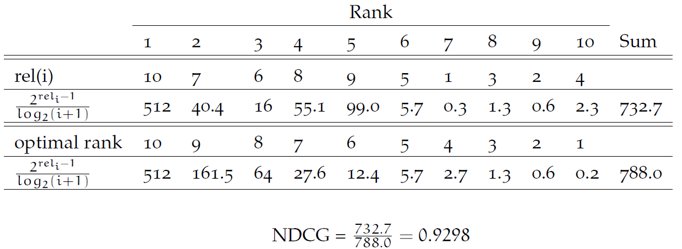
NDCG, an example calculation

Slide 14
There is more to ranking than being accurate
Scalability

Slide 15
Research Scope
We focus on exploring the scalability of the “most accurate” ranking methods.
But which are those “most accurate” ranking methods?

Slide 16


Many Benchmark datasets
LETOR 2.0
LETOR 3.0
LETOR 4.0
MSLR-web10/30k
Yahoo! Learning to Rank Challenge
Yandex Internet Mathematics Competition 2009
WCL2R
AOL

Slide 17
Search methodology
Forward reference search
Google scholar search

Slide 18
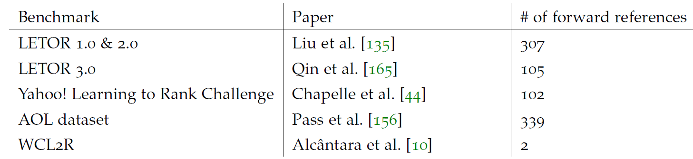
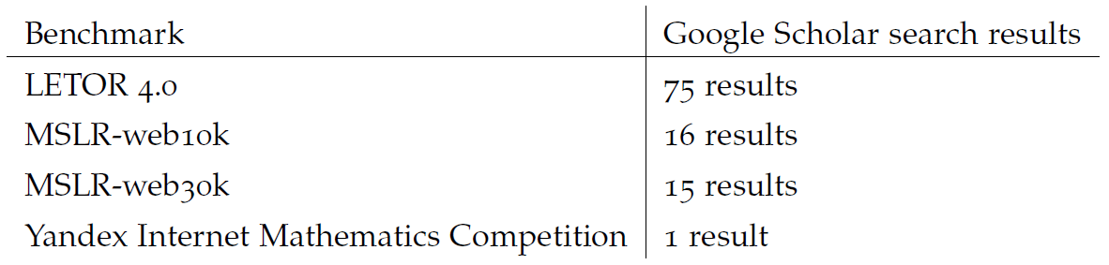
Search results

Slide 19
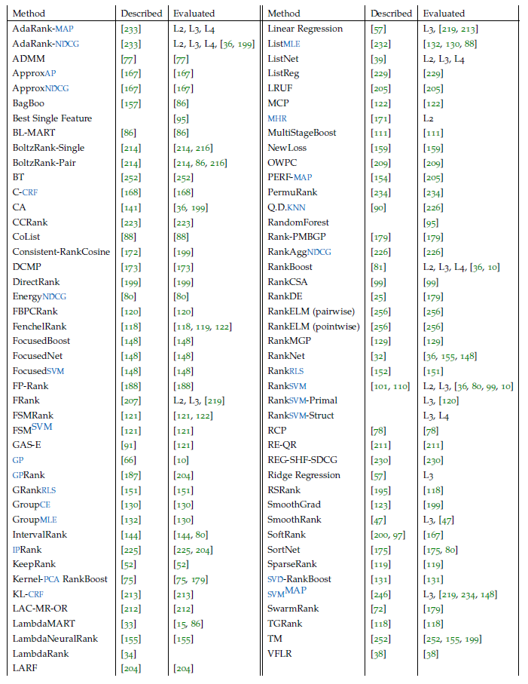

Slide 20
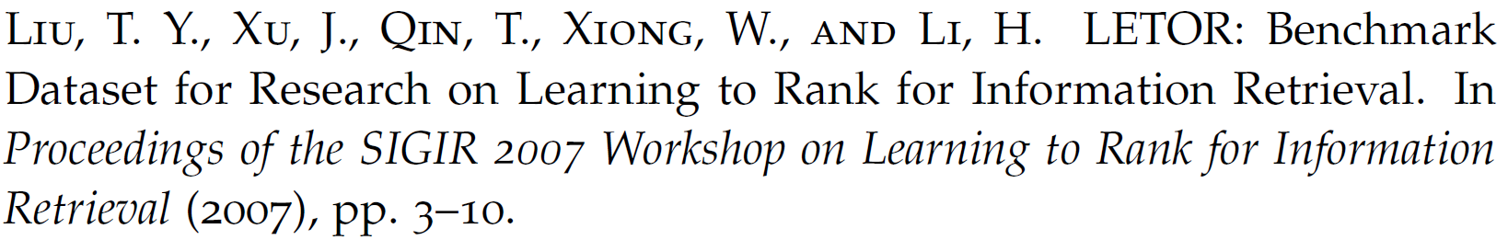
Comparison methodology
Winning Number (Liu et al., 2007)
Winning Number adapted for sparse evaluation sets:
Ideal Winning Number
Normalized Winning Number

Slide 21
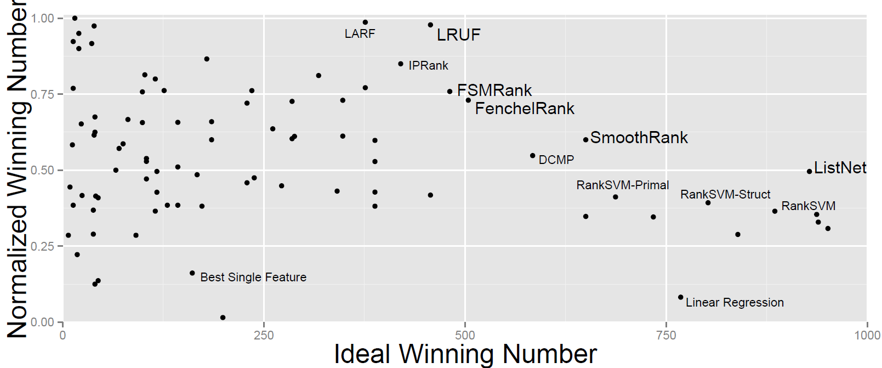
Comparison results

Slide 22
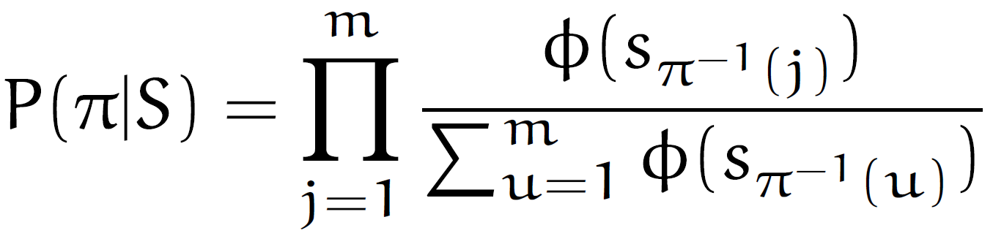
ListNet
Placket-Luce distribution:

Slide 23
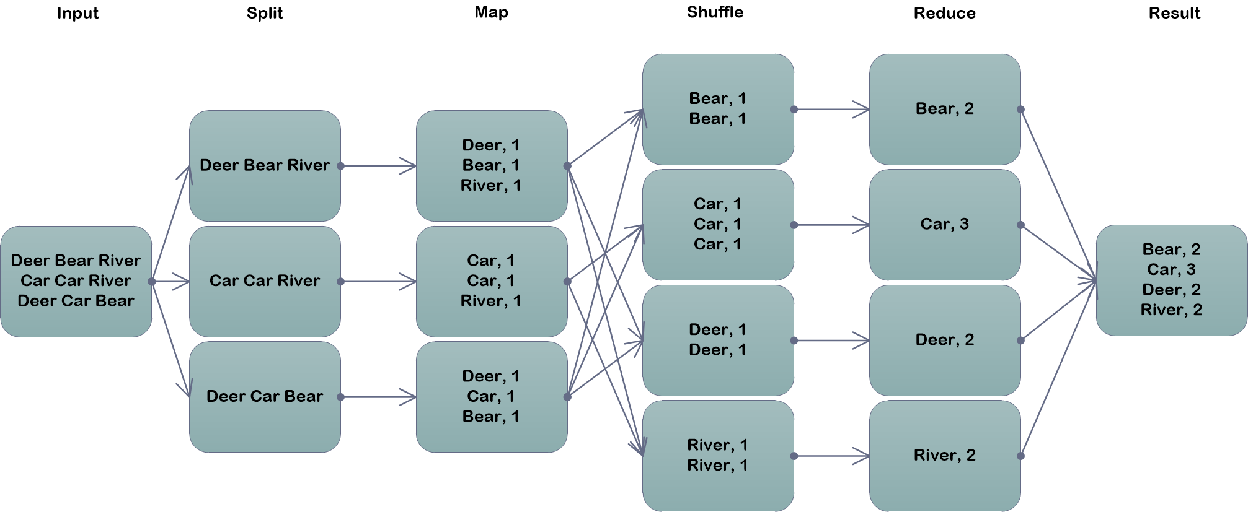
MapReduce

Slide 24
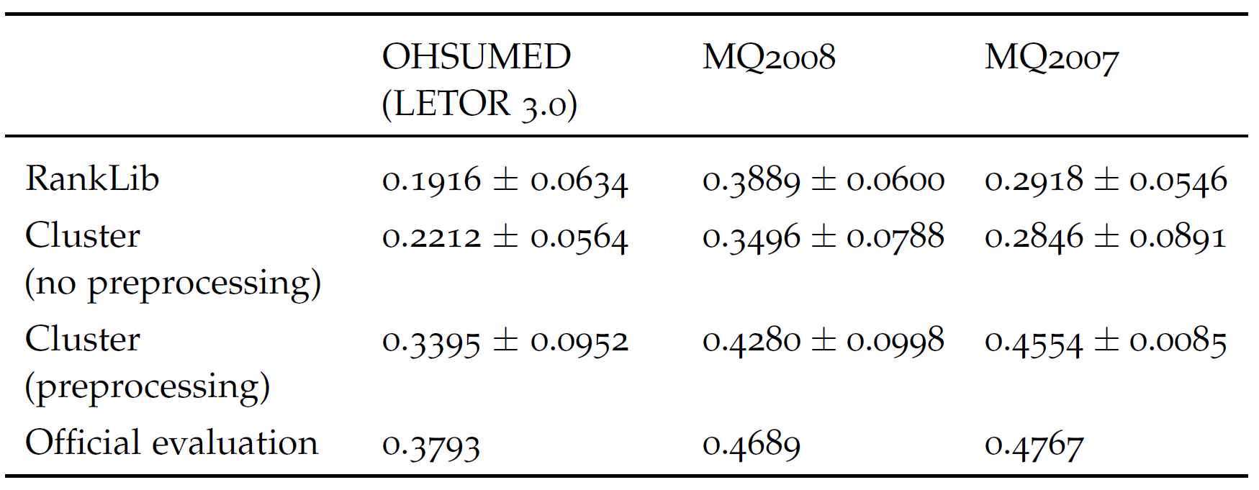
Preprocessing

Slide 25
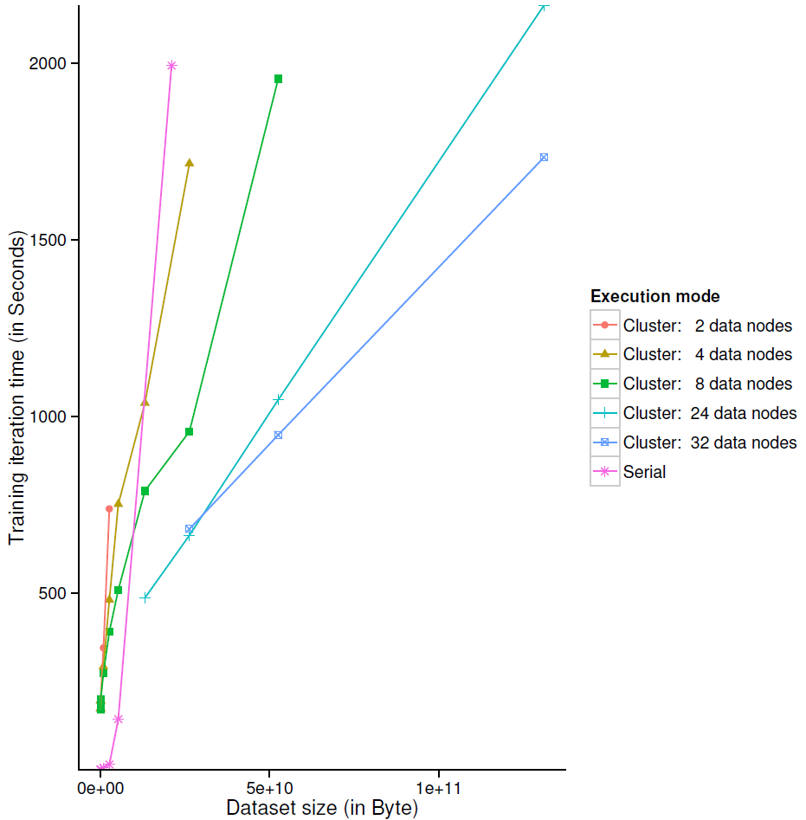

Slide 26
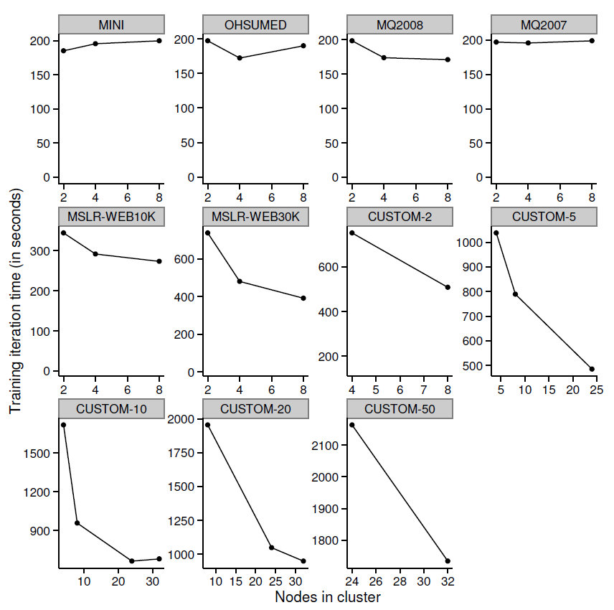

Slide 27
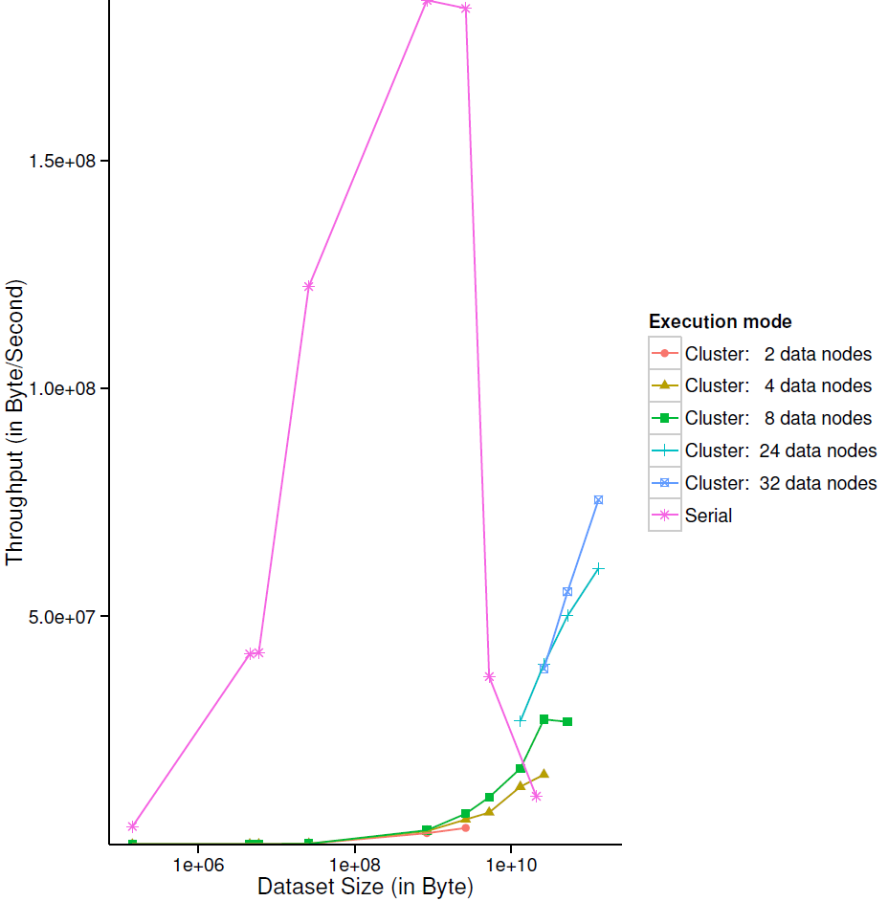

Slide 28
Conclusions & Contributions
New ranking algorithms comparison methodology
We found LRUF, FSMRank, FenchelRank, SmoothRank and ListNet to be the dominating Learning to Rank methods
High MapReduce job scheduling overhead: 150-200 seconds per iteration
Job scheduling overhead is independent of data set size
Single-machine ListNet does not scale well to data sets larger than physical memory
MapReduce can increase processing speed of data sets larger than physical memory
A normalisation preprocessing step improves the convergence rate of ListNet

Slide 29
Future work
Distributed computing models
Learning to Rank algorithms
Optimisation algorithms

